Slide 1
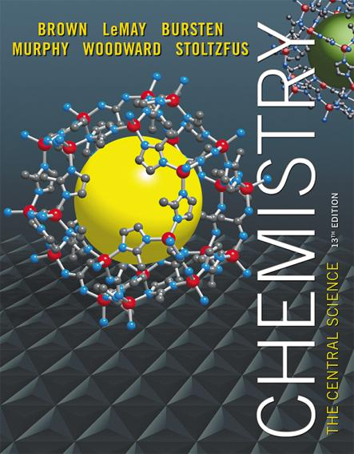
Lecture Presentation
Chapter 18 Chemistry of the Environment
© 2015 Pearson Education, Inc.

Slide 2
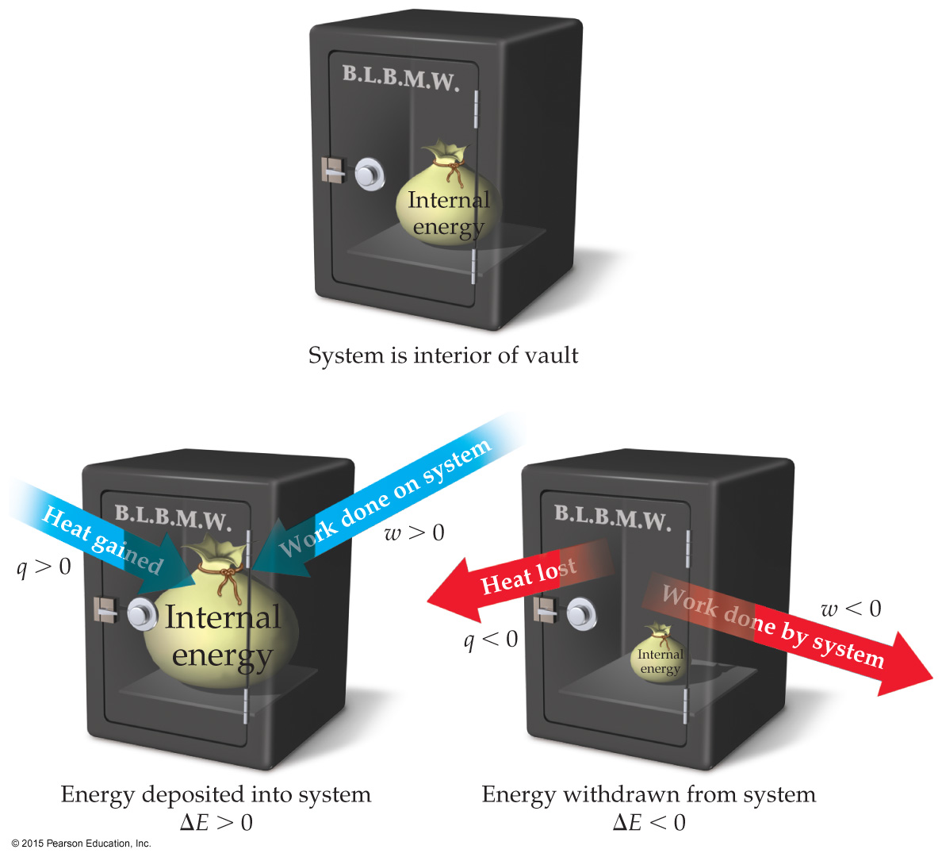
Changes in Internal Energy
When energy is exchanged between the system and the surroundings, it is exchanged as either heat (q) or work (w).
That is, ΔE = q + w.
Exergonic process must be exothermic (right or wrong?)

Slide 3
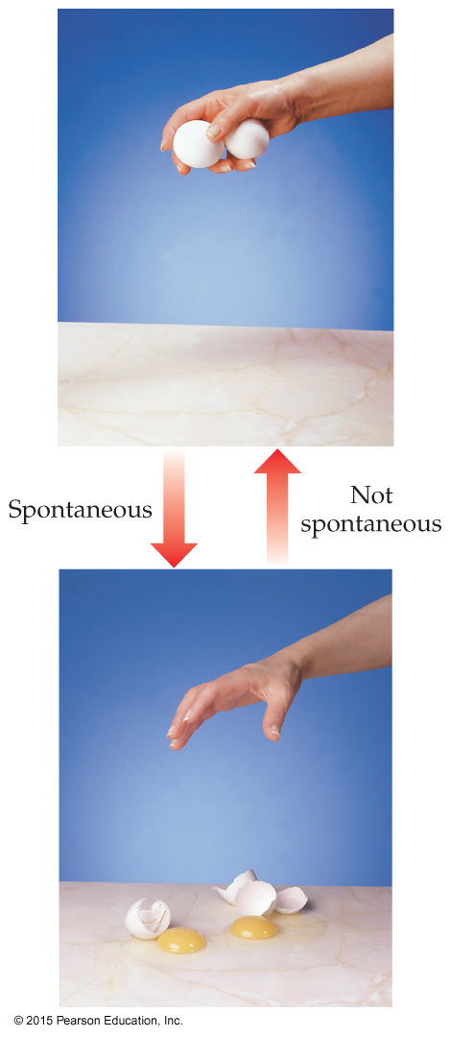
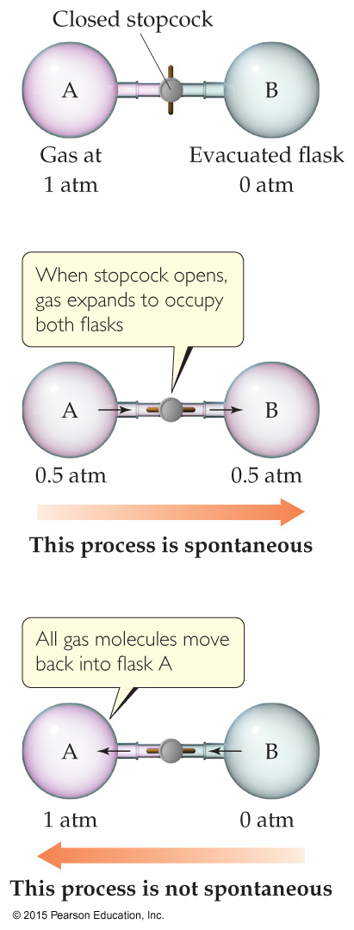
Spontaneous Processes
Spontaneous processes proceed without any outside assistance.
The gas in vessel A will spontaneously effuse into vessel B, but it will not spontaneously return to vessel A.
Processes that are spontaneous in one direction are nonspontaneous in the reverse direction.

Slide 4
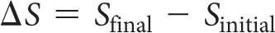
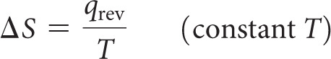
Entropy
Entropy can be thought of as a measure of the randomness of a system.
It is a state function:
It can be found by heat transfer from surroundings at a given temperature:

Slide 5
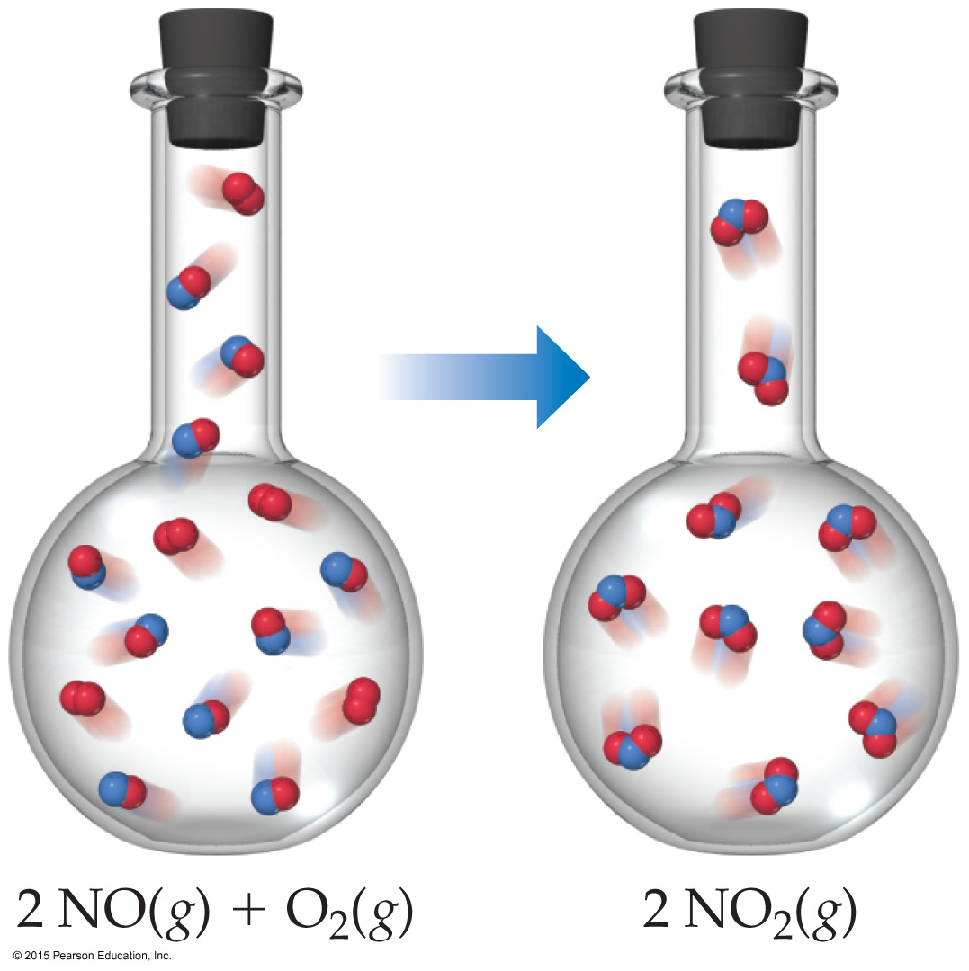
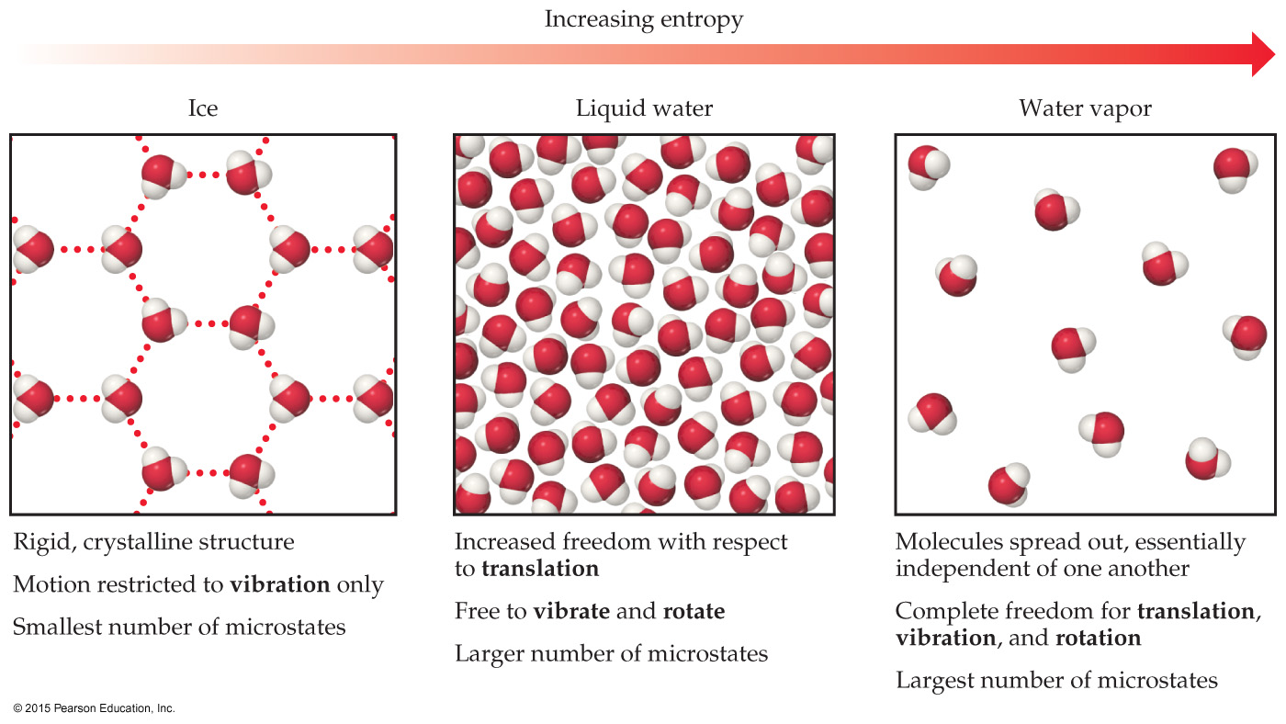
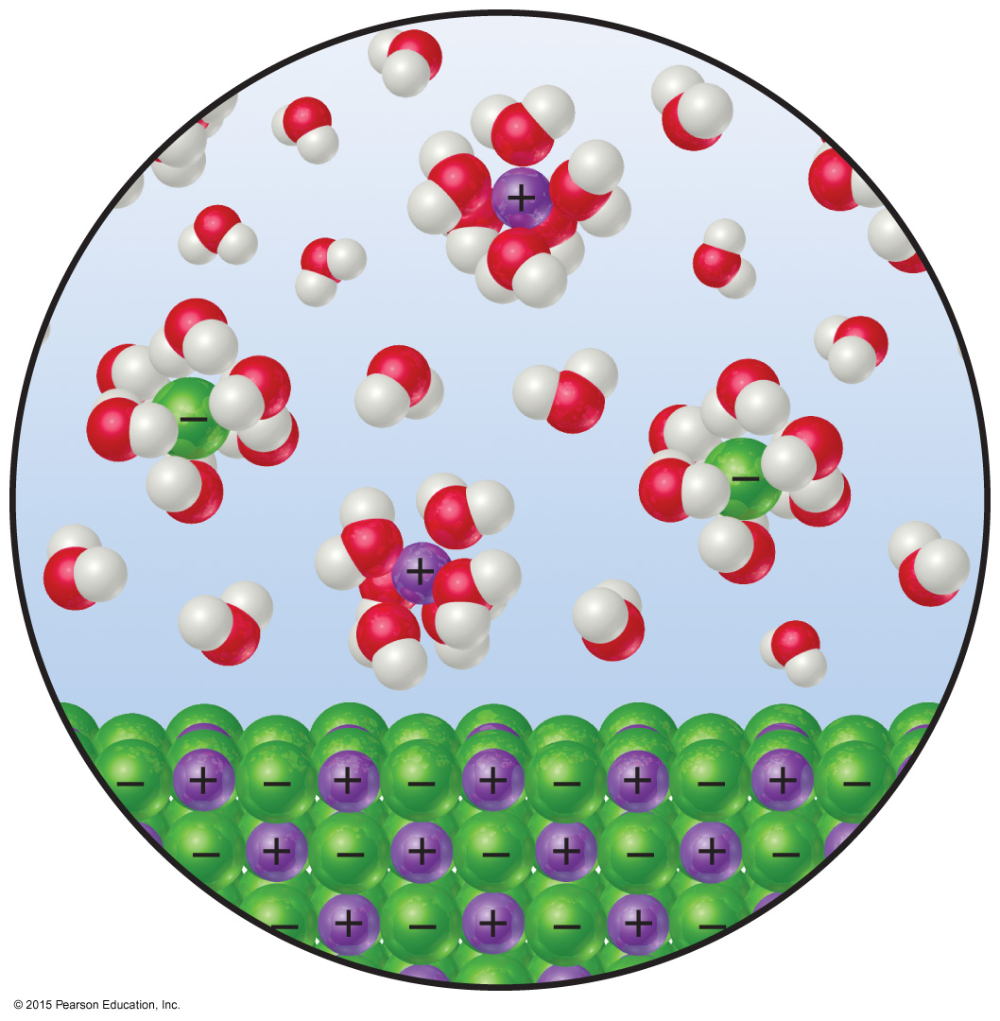
Entropy and Physical States
Entropy increases with the freedom of motion of molecules.
S(g) > S(l) > S(s)
Entropy of a system increases for processes where
gases form from either solids or liquids.
liquids or solutions form from solids.
the number of gas molecules increases during a chemical reaction.

Slide 6
Total Entropy and Spontaneity
ΔS_{universe} = ΔS_{system} + ΔS_{surroundings}
Substitute for the entropy of the surroundings:
ΔS_{universe} = ΔS_{system} – ΔH_{system}/T
Multiply by −T:
−TΔS_{universe} = −TΔS_{system} + ΔH_{system}
Rearrange:
−TΔS_{universe} = ΔH_{system} − TΔS_{system}
Call −TΔS_{universe} the Gibbs Free Energy (ΔG):
ΔG = ΔH − T ΔS

Slide 7
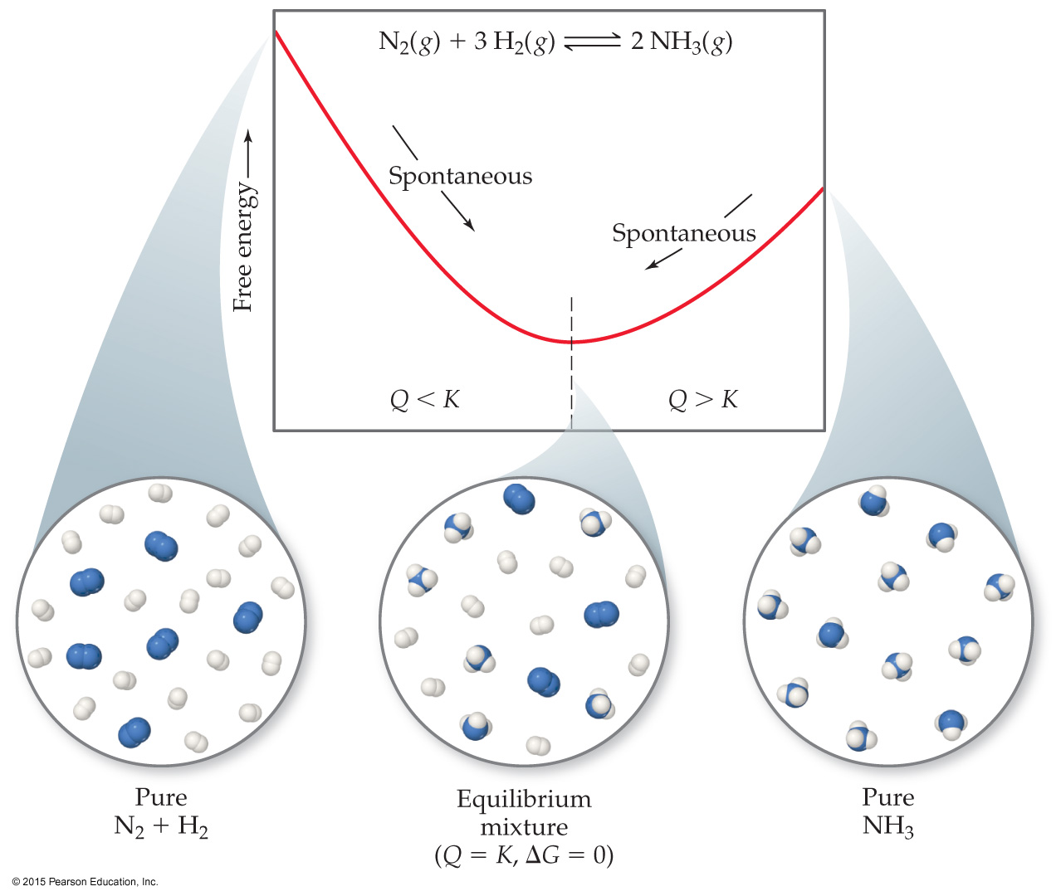
Gibbs Free Energy
If ΔG is negative, the forward reaction is spontaneous.
If ΔG is 0, the system is at equilibrium.
If ΔG is positive, the reaction is spontaneous in the reverse direction.

Slide 8
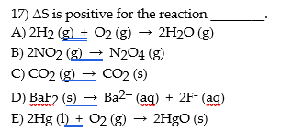
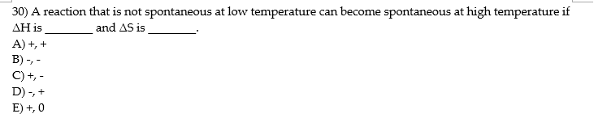

Slide 9
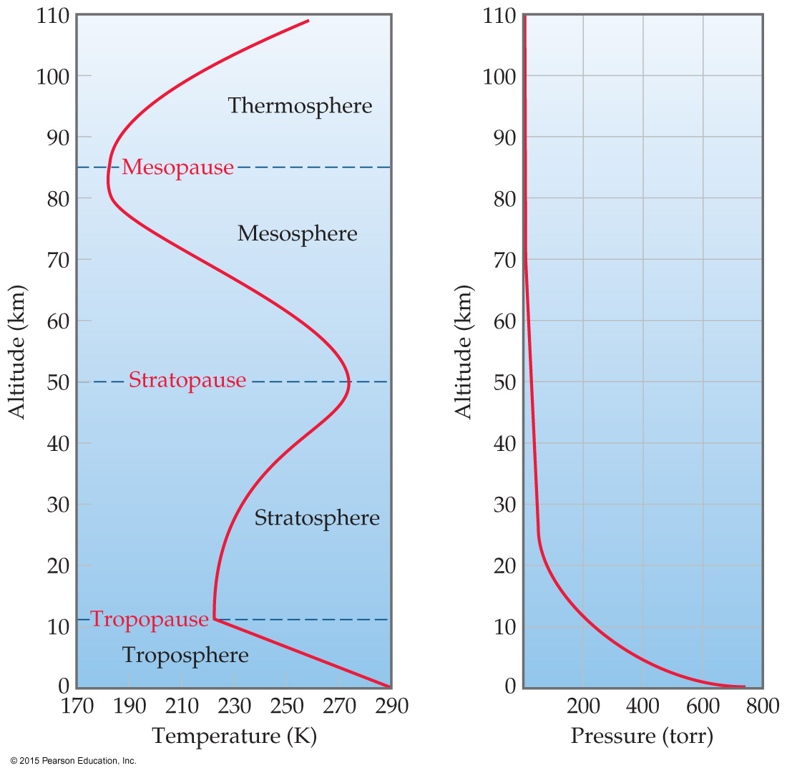
Atmosphere
The atmosphere consists of the troposphere, stratosphere (combined 99.9 mass %), mesosphere, and thermosphere.
Temperature varies greatly with altitude. Within the troposphere (where we live), as altitude increases, temperature decreases.
Pressure decreases with altitude in the atmosphere.

Slide 10
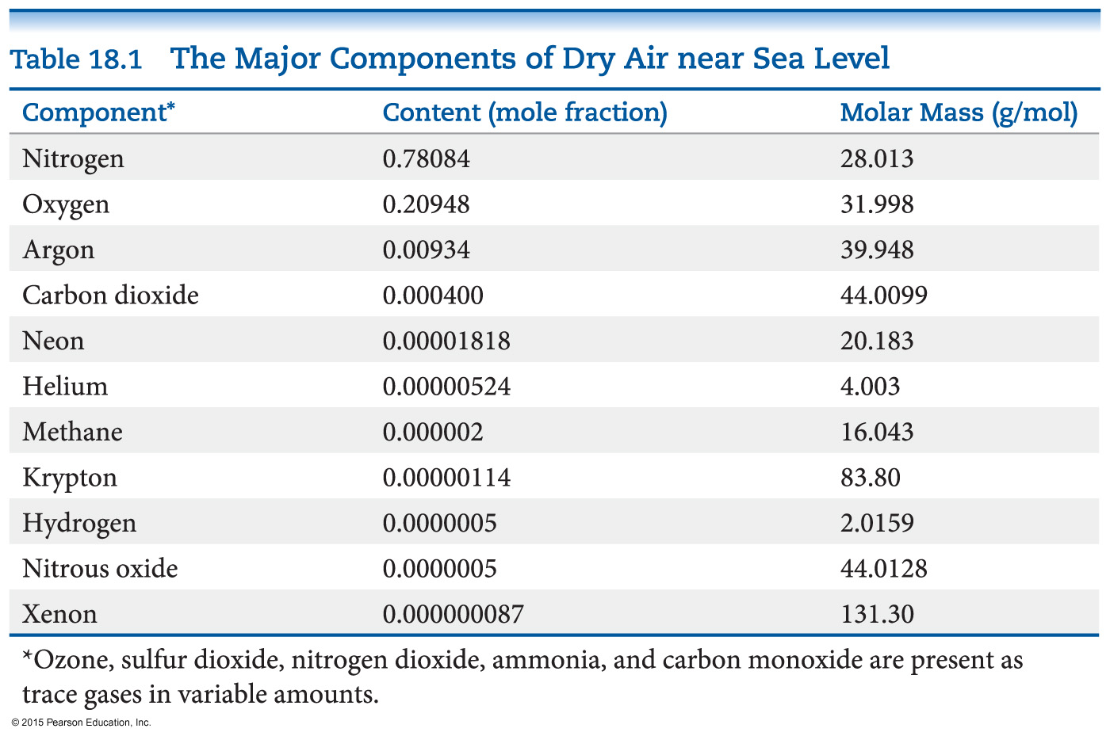
Composition of the Atmosphere
The composition of gases in the atmosphere is not uniform.
Heavier gases tend to “sink” in the atmosphere, leaving lighter ones at the top.
Near sea level, the majority of the atmosphere is nitrogen and oxygen.

Slide 11
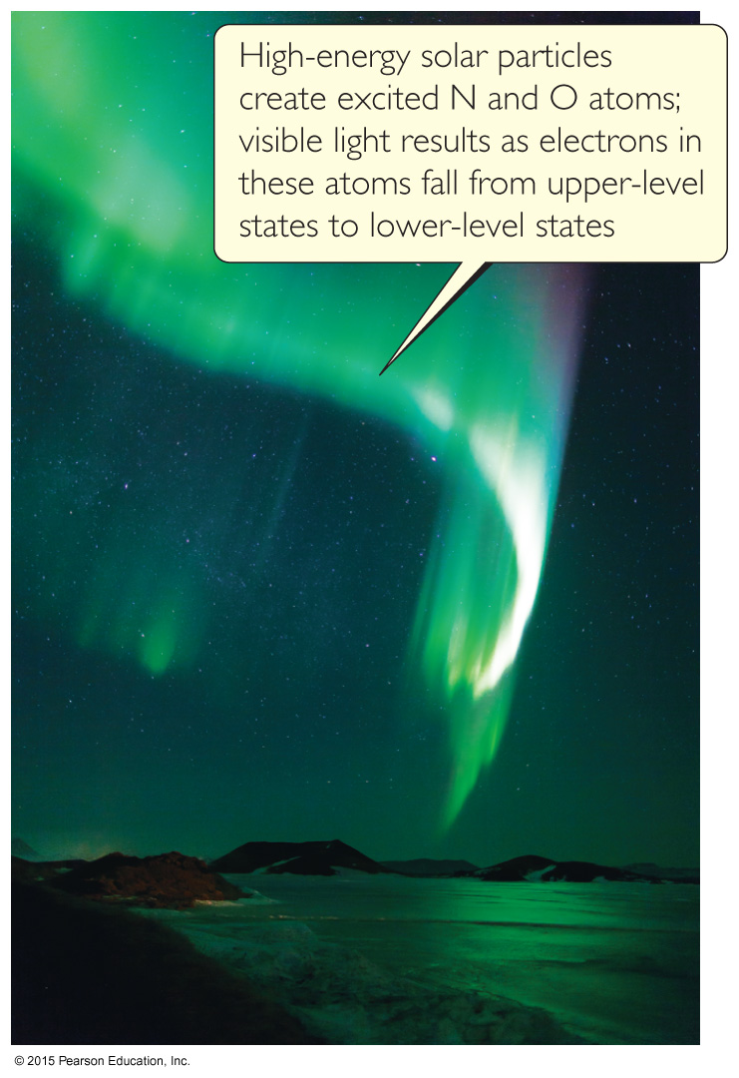
Chemistry of Nitrogen and Oxygen
Nitrogen is largely unreactive due to the bond energy associated with breaking the N≡N.
Oxygen has a much lower bond enthalpy than nitrogen, and is therefore more reactive.
Oxides of nonmetals are acidic; oxides of active metals are basic.

Slide 12
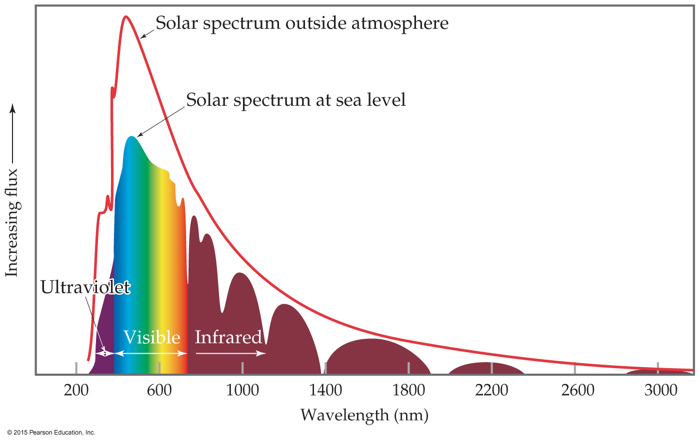
Photochemical Reactions in the Atmosphere
Beyond the stratosphere is where the “outer defense” of Earth against radiation and high-energy particles occurs.
Chemical changes which occur there can be described as phtotodissociation or photoionization.

Slide 13
Photodissociation
Rupture of a bond due to absorption of a photon
Ions are not formed; radicals (having unpaired electrons) are often formed.
One of the most important reactions in the upper atmosphere is the photodissociation of oxygen molecules to oxygen atoms:

Slide 14
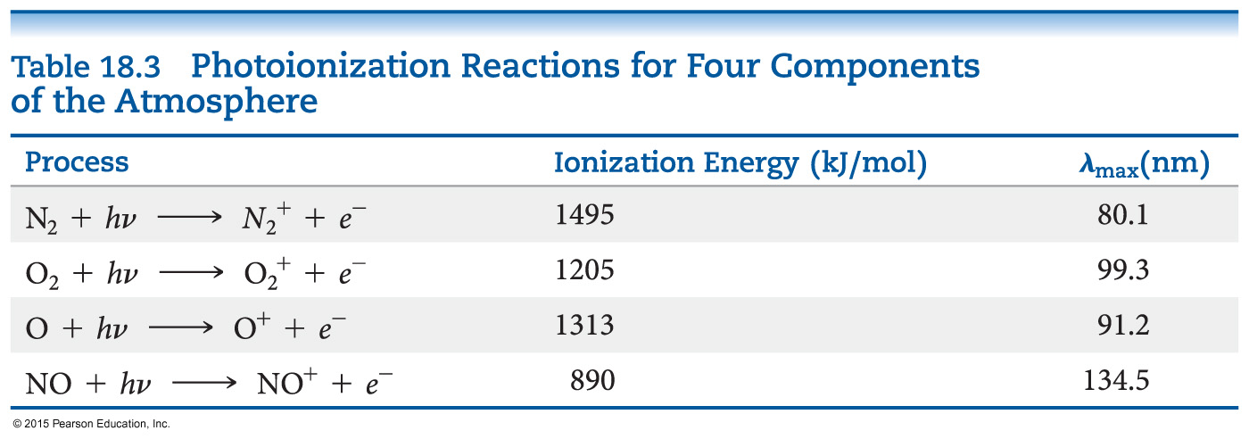
Photoionization
Sometimes when molecules in the upper atmosphere absorb solar radiation, they emit electrons; this is photoionization.
The result is formation of a cation.

Slide 15
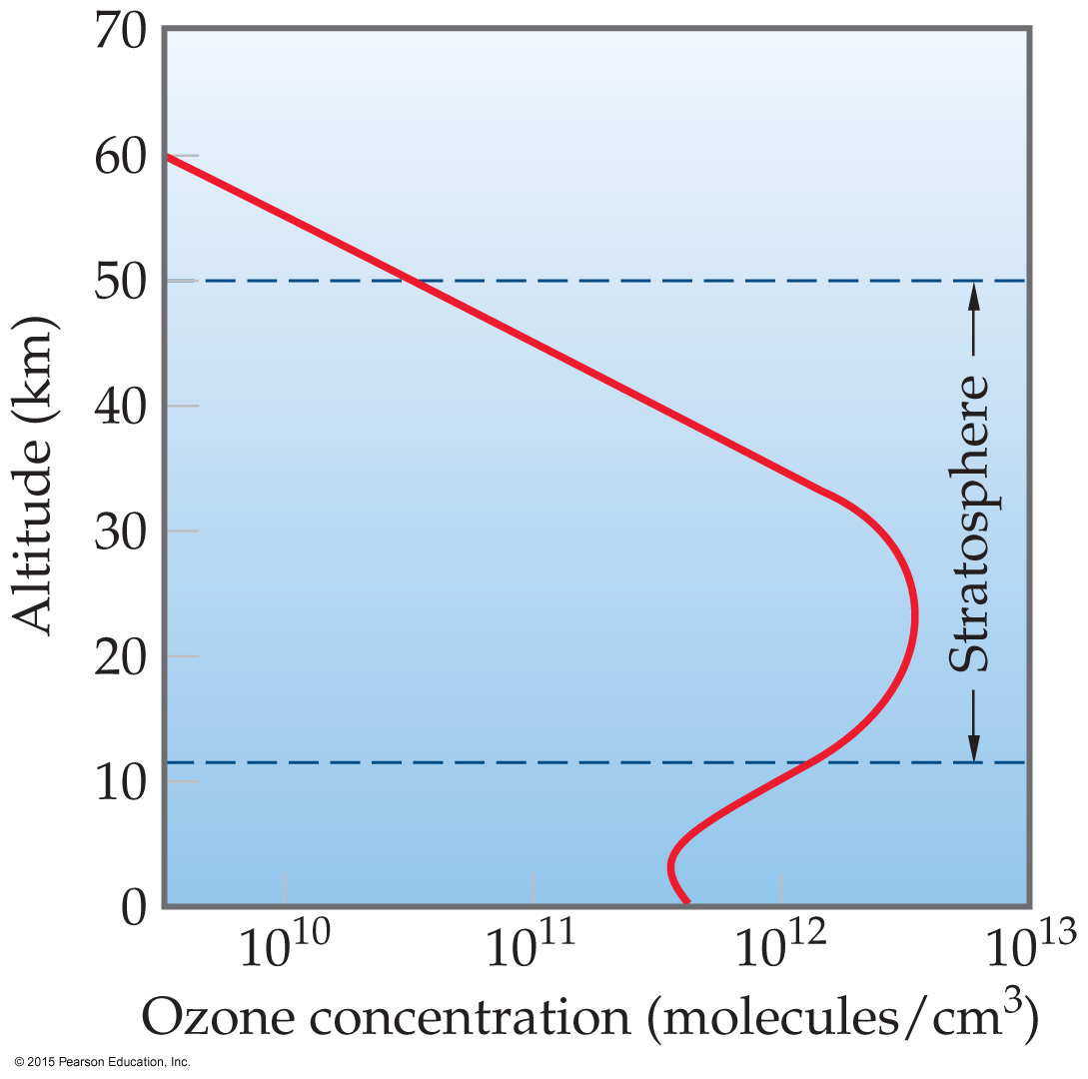
Ozone
Ozone absorbs much of the radiation between 240 and 310 nm, protecting us from UV radiation.
It forms from reaction of molecular oxygen with the oxygen atoms produced in the upper atmosphere by photodissociation.
O + O₂ → O₃
The ozone layer occurs in the stratosphere, at an altitude of about 25 km.
Notes:
Cosmetic product

Slide 16
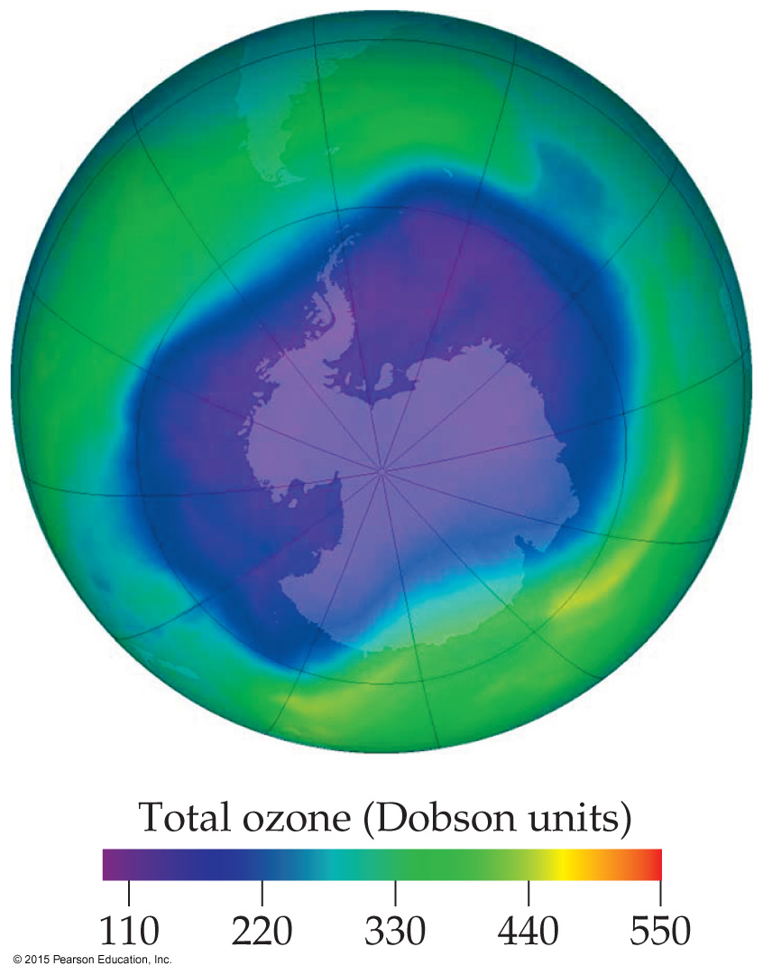
Ozone Depletion
In 1974 Rowland and Molina discovered that chlorine from chlorofluorocarbons (CFCs) may be depleting the supply of ozone in the upper atmosphere by chemical means.
Despite a ban on CFCs in over 100 countries, ozone depletion will continue because of the chemical nature of CFCs.

Slide 17
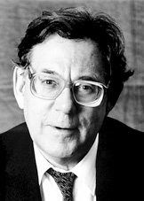
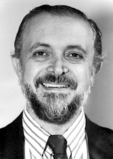
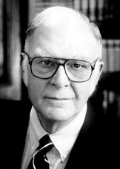
The Nobel Prize in Chemistry 1995
"for their work in atmospheric chemistry, particularly
concerning the formation and decomposition of ozone"
Paul J. Crutzen
Mario J. Molina
F. Sherwood Rowland

Slide 18
Chlorofluorocarbons (CFCs)
CFCs were used for years as aerosol propellants and refrigerants.
They are not water soluble (do not get washed out of the atmosphere by rain) and are quite unreactive (not degraded naturally).
The C—Cl bond is easily broken by light with a wavelength between 190 and 225 nm in the stratosphere, where the ozone layer exists.
The chlorine atoms formed react with ozone:
Cl + O₃ → ClO + O₂

Slide 19
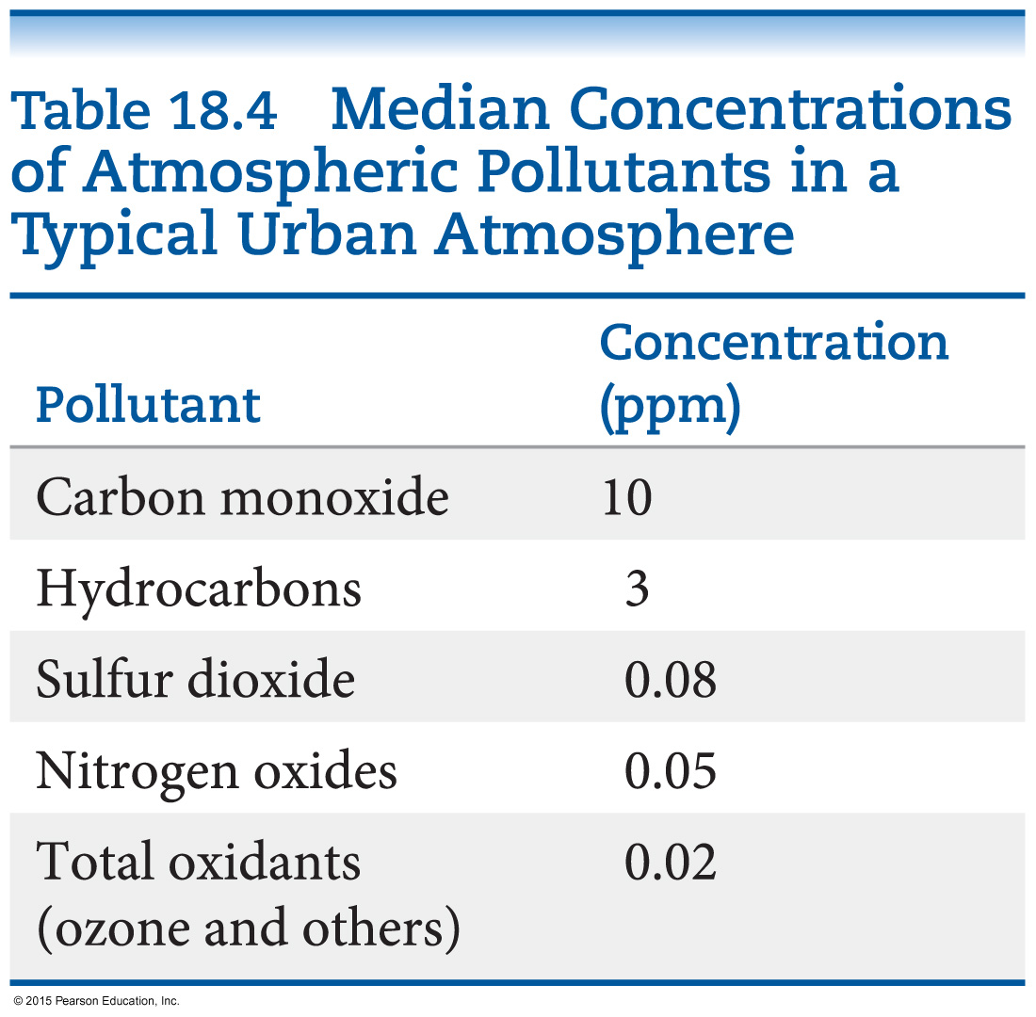
Pollutants in the “Average” City
The table lists pollutant gases present in the “typical” urban environment.
It assumes no major smog problems in the city.
Although the typical value for SO₂ is low, it is considered the most serious health hazard on the list.

Slide 20
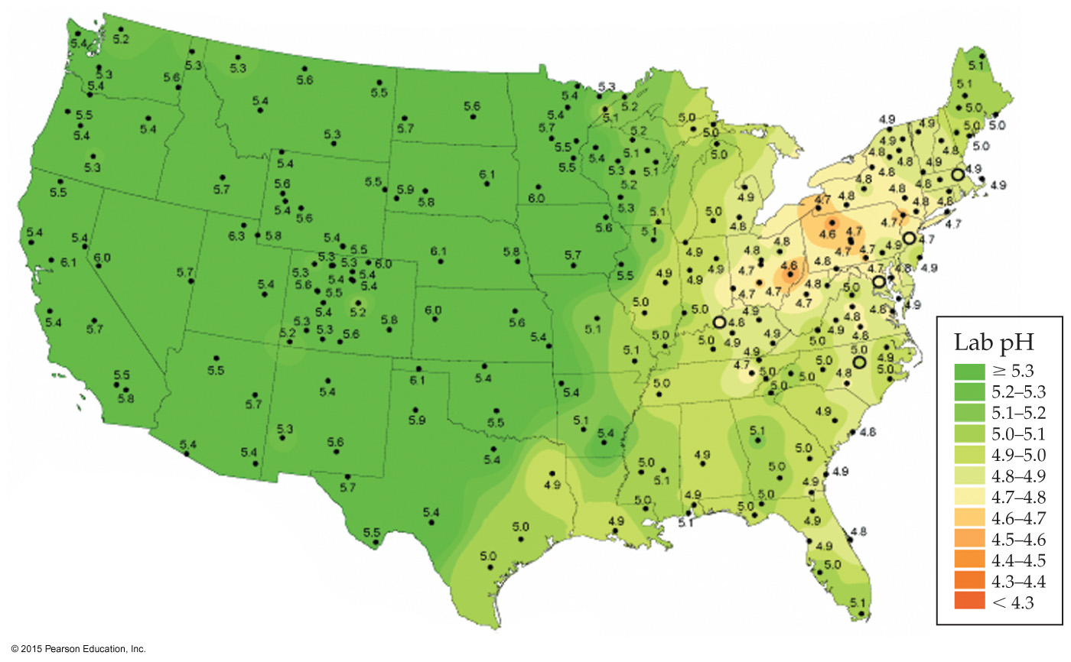
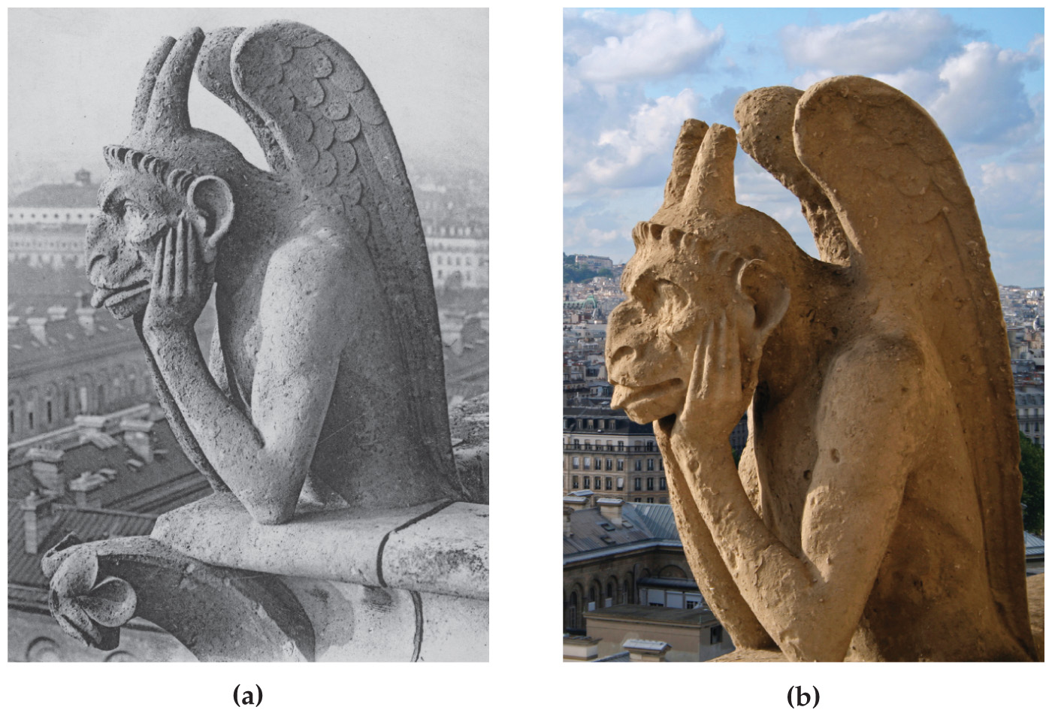
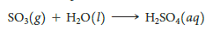
Acid Rain
SO₂ is a by-product of the burning of coal or oil.
It reacts with moisture in the air to form sulfuric acid.
It is primarily responsible for acid rain. (Nitrogen oxides also contribute to acid rain.)
High acidity in rainfall causes corrosion in building materials.

Slide 21
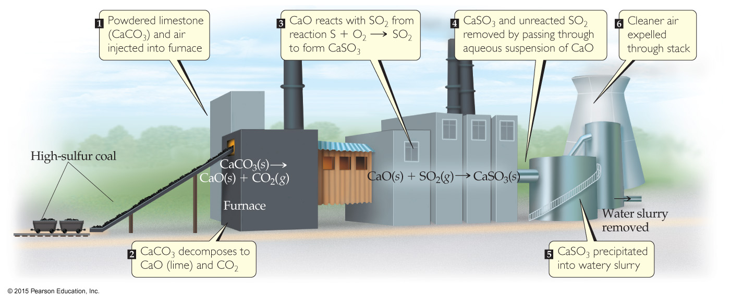
Chemical Methods to Prevent Emissions from Power Plants
Powdered limestone (CaCO₃) can be added to the furnace of a power plant. It is converted to CaO, which reacts with SO₂ to make CaSO₃.
Gases can pass through a suspension of CaO, with the same result.
Notes:
Ca sulphurous

Slide 22
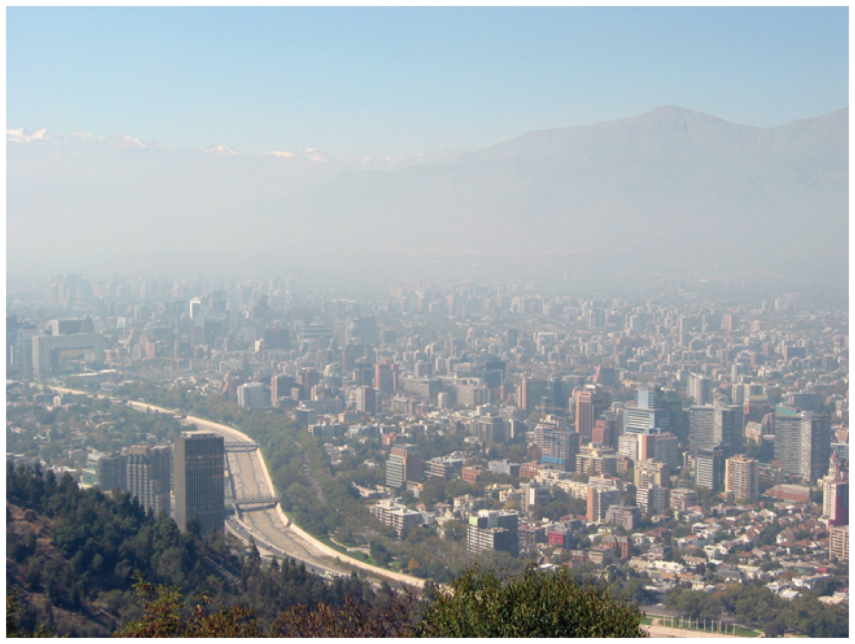
Nitrogen Oxides & Smog
Smog, that brownish gas that hangs above large cities, is primarily nitrogen dioxide, NO₂.
It forms from the oxidation of nitric oxide, NO, a component of car exhaust.
These nitrogen oxides are just some components of photochemical smog.
Ozone, carbon monoxide, and hydrocarbons also contribute to air pollution that causes severe respiratory problems in many people.

Slide 23
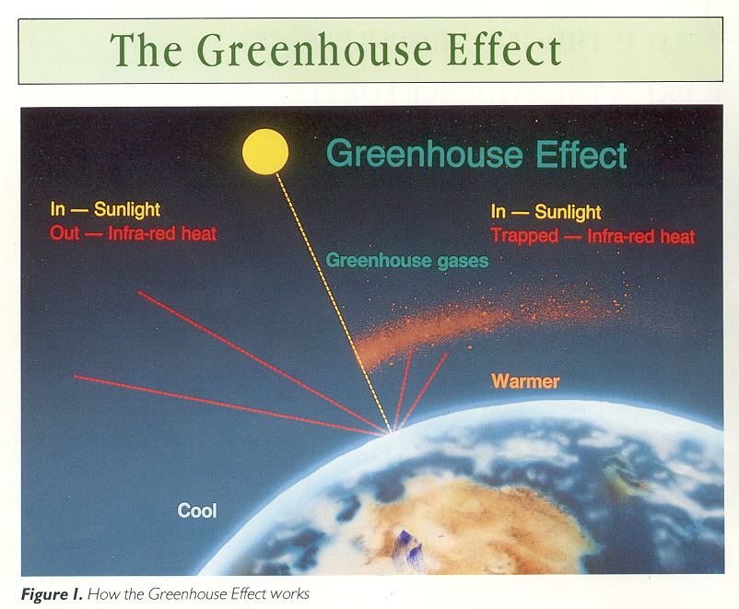

Slide 24
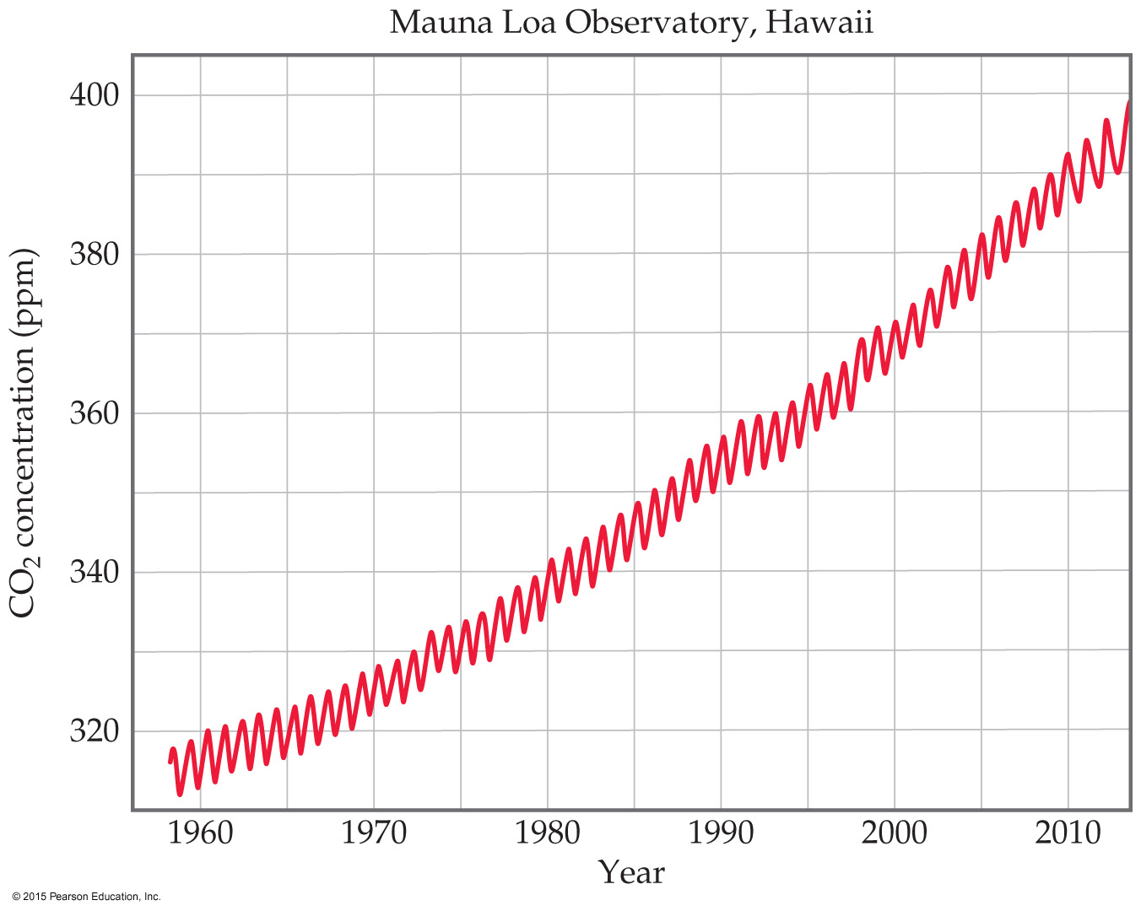
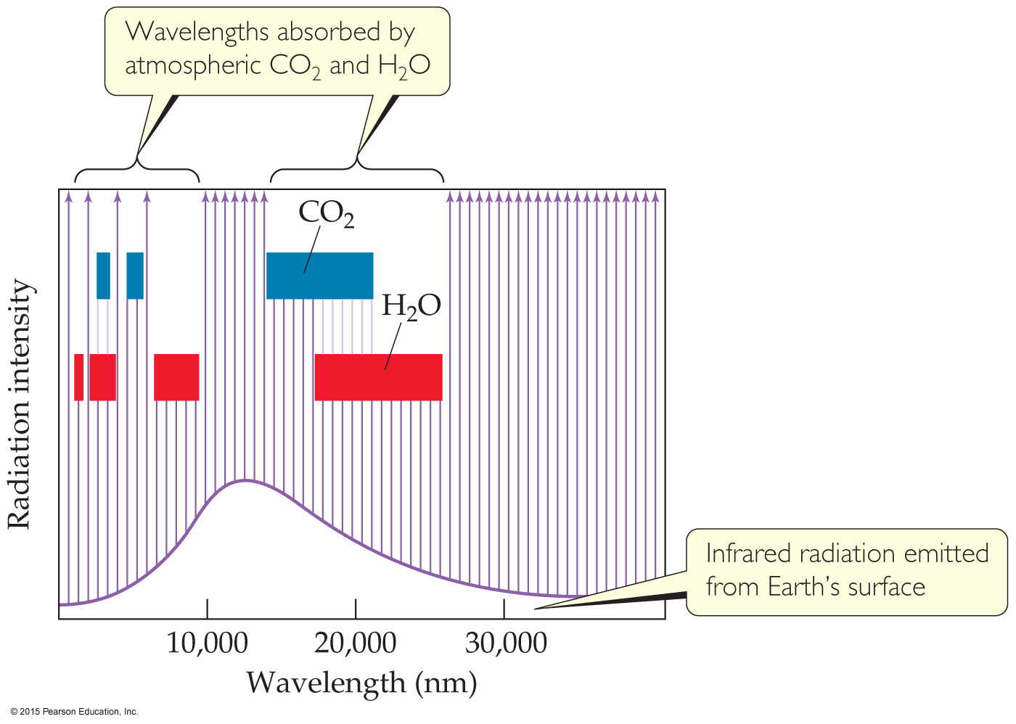
The Greenhouse Effect
Carbon dioxide and water vapor absorb some radiation from the surface; the ozone layer prevents some radiation from entering; the overall balance keeps the Earth’s surface temperature consistent.

Slide 25
The Effect of Increasing Amounts of Carbon Dioxide
Water is the major absorber of radiation; its levels vary by location and time of year
CO₂ levels from human use of fossil fuels (primarily coal and oil) have increased dramatically over the last century.
This is likely causing an unnatural increase in atmospheric temperatures.

Slide 26
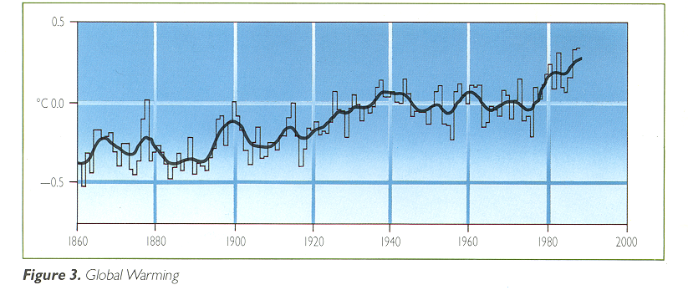
Global Warming

Slide 27
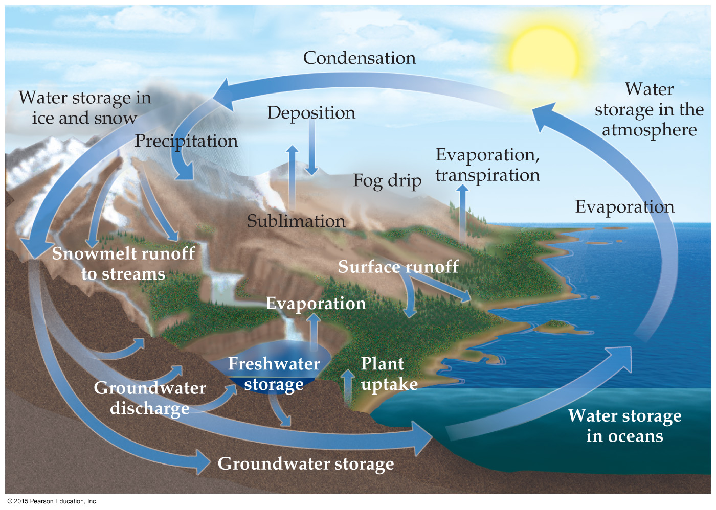
The Global Water Cycle
Most of the processes depicted here depend on the phase changes of water.

Slide 28
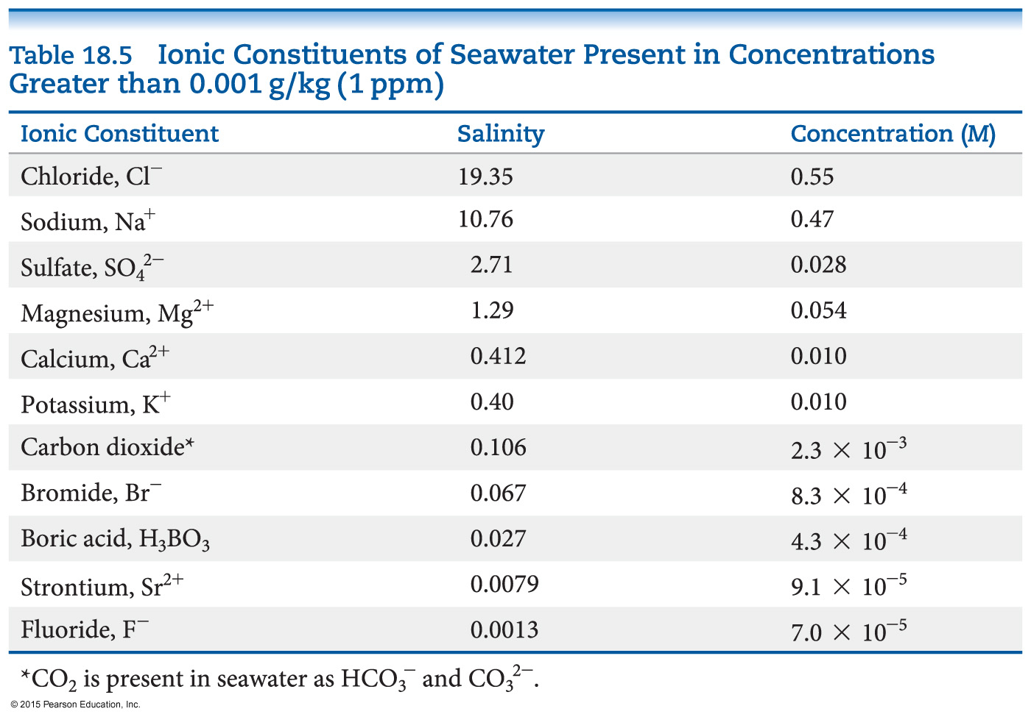
The World Ocean
97.2% of all water on Earth is in the ocean.
The vast ocean contains many important compounds and minerals.
However, the ocean is only a commercial source of sodium chloride, bromine (from bromide salts), and magnesium (from its salts).
Absorption of CO₂ in oceans plays a major role in the global climate.

Slide 29
Fresh Water
All fresh water is only about 0.6% of water on the planet.
U.S. use of fresh water:
Agriculture (41%)
Hydroelectric power (39%)
Industry (6%)
Household needs (6%)
Drinking water (1%)
Use of water adds dissolved materials, including human wastes; it will become increasingly expensive to guarantee our water supply.

Slide 30
Groundwater
Groundwater is fresh water under the soil in aquifers.
Approximately 20% of the world’s fresh water is groundwater.
When used, these sources of water are not readily regenerated. It takes a long time for water to penetrate the rock layers which create an aquifer.
Not all groundwater is potable. Due to the ions in rock formations, some will contain poisons, like arsenic, in high levels.
Water contains excessive amount of Ca²⁺ and Mg²⁺ is called hard water.

Slide 31
Dissolved Oxygen and Water Quality
The amount of O₂ in water is an important indicator of water quality.
When aerobic bacteria act on biodegradable matter, they use oxygen.
Excessive amounts of biodegradable matter can result in inability of normal animal life to exist in the water.
It can also lead to anaerobic oxidation conditions, which give off bad odors.
Excessive plant nutrients can lead to eutrophication, or excessive dead plant matter in water.

Slide 32
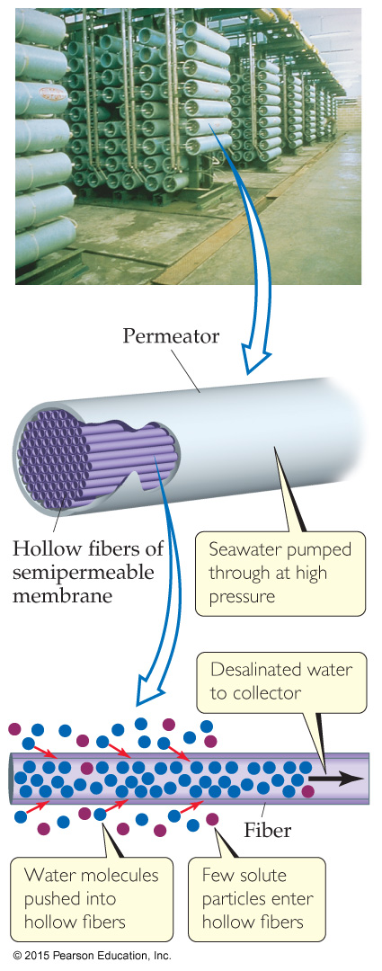
Water Purification—Desalination
Seawater has too high a concentration of NaCl for human consumption.
It can be desalinated through reverse osmosis.
Water naturally flows through a semipermeable membrane from regions of low salt concentration to regions of high salt concentration.
If pressure is applied, the water can be forced through a membrane in the opposite direction, concentrating the pure water.

Slide 33
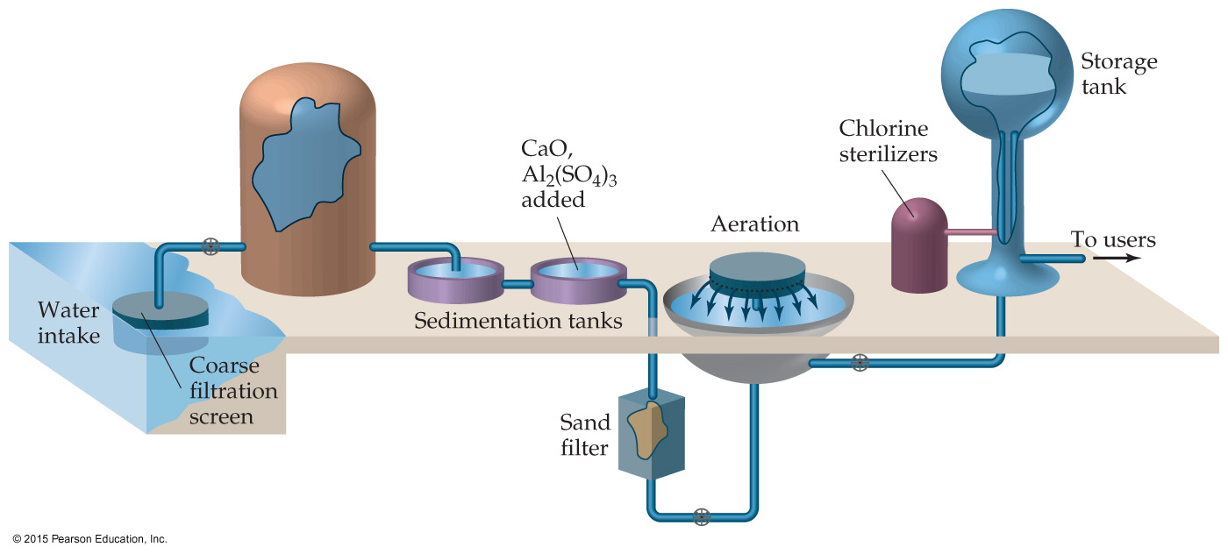
Water Purification— Municipal Water Treatment
Steps to purifying water for a municipal supply:
CaO and Al₂(SO₄)₃ are added for the removal of very small particles.
Water is aerated to increase amount of dissolved oxygen and for oxidation of organic impurities.
Ozone or chlorine is used to disinfect the water.

Slide 34
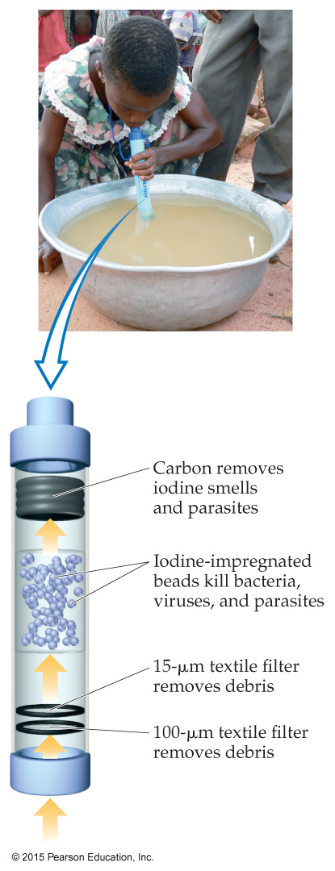
Water Purification—LifeStraw
As one sucks water through the straw, filters remove most of the sediment and bacteria.
Iodine-impregnated beads then kill viruses and bacteria.
Charcoal removes the iodine smell and most remaining parasites.

Slide 35
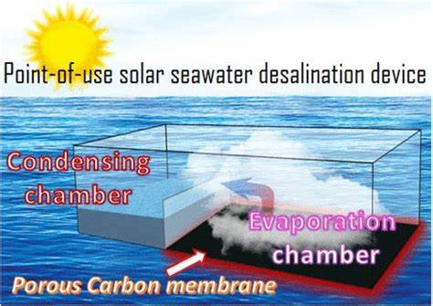

Slide 36
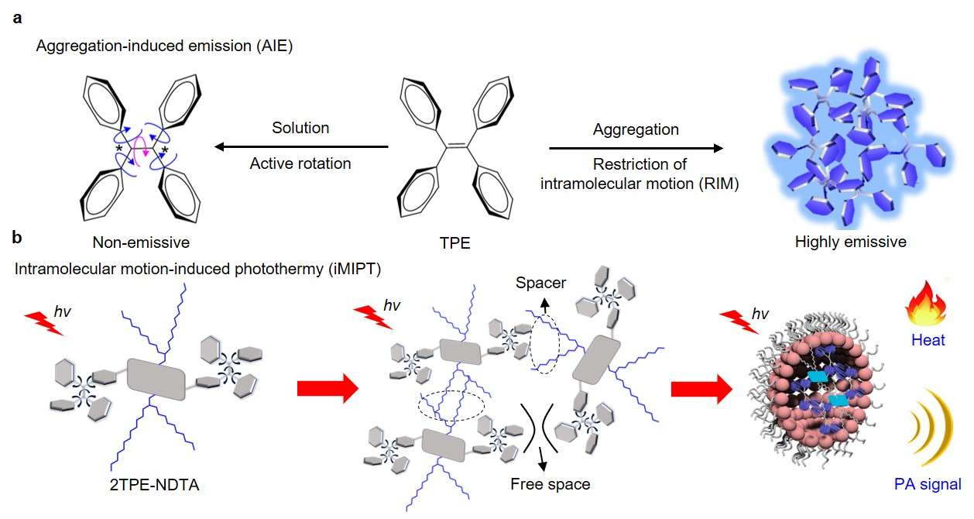

Slide 37
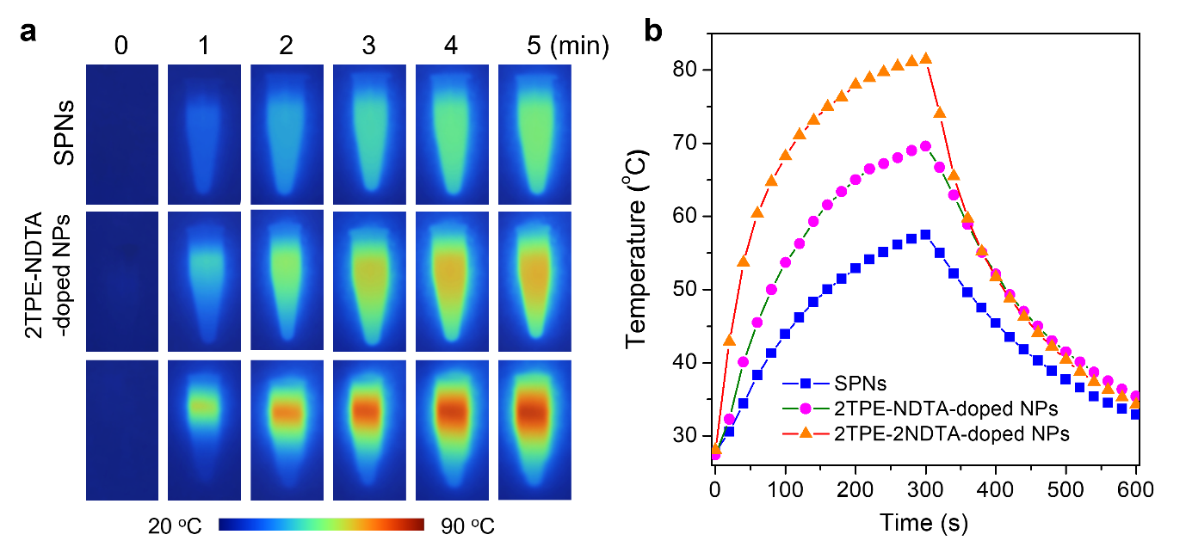
2TPE-2NDTA
-doped NPs
Nat. Commun. 2019

Slide 38
Green Chemistry
The Earth can largely be considered a closed system, which can exchange energy with the rest of the universe, but energy keeps inside its mass.
For humanity to thrive, we need to keep our processes in balance with Earth’s natural processes.
This is the basis for Green Chemistry.
Green Chemistry is an initiative that promotes the design and application of chemical products and processes that are compatible with human health and that preserve the environment.

Slide 39
Green Chemistry Principles
Prevention: It is better to prevent waste than to clean it up after it has been created.
Atom Economy: Methods to make chemical compounds should be designed to maximize the incorporation of all starting atoms into the final product.
Less Hazardous Chemical Syntheses: Wherever practical, synthetic methods should be designed to use and generate substances that possess little or no toxicity to human health and the environment.

Slide 40
Green Chemistry Principles
Design of Safer Chemicals: Chemical products should be designed to minimize toxicity and yet maintain their desired function.
Safer Solvents and Auxiliaries: The use of auxiliary substances should be eliminated wherever possible and, if used, should be as nontoxic as possible.
Design for Energy Efficiency: Energy requirements should be recognized for their environmental and economic impacts and should be minimized (e.g., carry out reactions at room temperature and pressure).

Slide 41
Green Chemistry Principles
Use of Renewable Feedstocks: A raw material should be renewable whenever technically and economically practical.
Reduction of Derivatives: Unnecessary derivatization should be minimized or avoided if possible to save reagents and waste.
Catalysis: Catalytic reagents improve yields within a given time and with less energy and are, therefore, preferred.

Slide 42
Green Chemistry Principles
Design for Degradation: Chemical products should be designed so that at the end of their function they break down into innocuous products and do not persist in the environment.
Real-Time Analysis for Pollution Prevention: Analytical methods should be developed to allow for real-time monitoring and control prior to the formation of hazardous substances.
Inherently Safer Chemistry for Accident Prevention: Reagents and solvents used in a chemical process should be chosen to minimize the potential for chemical accidents.

Slide 43
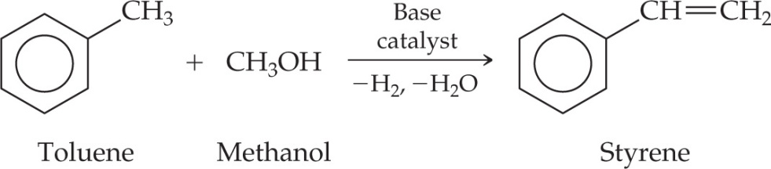
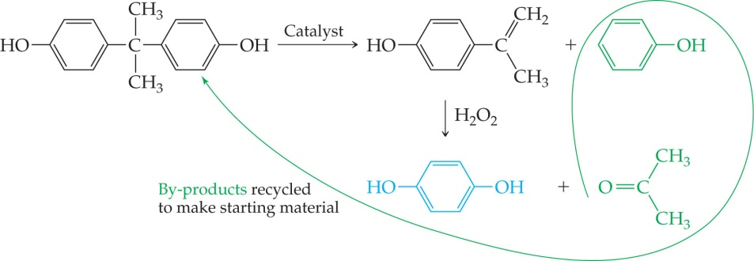
Examples of Green Chemistry
Preparation of styrene using toluene and methanol
Replacing chlorofluorocarbon solvents with liquid or supercritical CO₂
Hydroquinone production by a new method that recycles by-products

Slide 44
Examples of Green Chemistry
Catalytic chemical process –metathesis
(2005 Nobel Prize) for less energy, less greenhouse gas emission
Computer chips manufacturing – uses supercritical CO2 fluid
Medicines with less side effects
Biodegradable plastics – “Ecoflex”

Slide 45
continued
Paint – a mixture of soya oil and sugar to replace fossil-fuel-derived paint
Water-based acrylic paints with low VOC – made from recycled soda bottle plastic (PET), acrylics and soyabean oil

